Slide 1


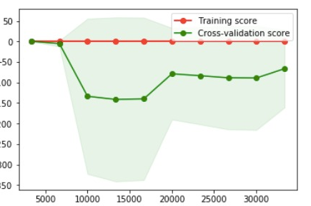
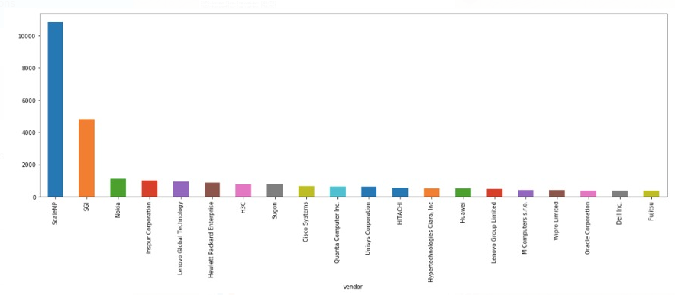
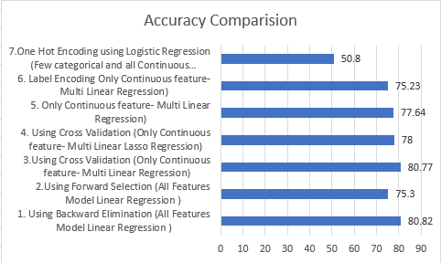
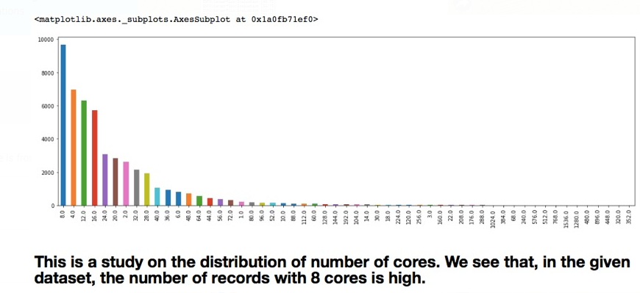
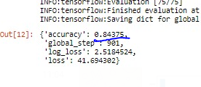
Flex Deep Learning & Framework Analysis Project
By: Avik
Introduction
Methodology
Result
Flex CEC engineering, needs to predict server or cluster application performance while meeting datacenter OpEx and CapEx constraints. An analysis is needed to verify the result with the expectations. Doing it manually takes time and this void is filled by this model which predicts part of the analysis that is the performance. Framework Analysis is done to compare frameworks efficiency
Data preprocessing( Encoding , etc)
Changing Test and Training Data Size.
Algorithm selection & Model experimentation( Linear Regression , Lasso , Logistic etc)
Defining and tuning hyperparameter like loss functions
Model Tuning
Experiment with Cross validation , Backward elimination , Forward selection
Experimenting with different permutation of above mention factors
Flex Project :1. Using Backward Elimination (All Features Model Linear Regression ) – 80.82% 2. Forward Selection (All Features Model Linear Regression )- 75.3% 3. Using Cross Validation (Only Continuous feature- Multi Linear Regression)-80.77% 4. Using Cross Validation (Only Continuous feature- Multi Linear Lasso Regression) -78.1% 5. Only Continuous feature- Multi Linear Regression) – 77.64% 6. One Hot Encoding using Logistic Regression (Cata & all Cont Feature)– 50.8%
Problem Statement
Experiments
Framework Analysis
The framework analysis included comparing the efficiency and accuracy of Various framework ( like Keras, Tensorflow etc ) by using same dataset and same standardized hyperparameter .
The Accuracy we found for Keras was 83.05% . The Accuracy for Tensorflow was 84.3% . In future We will be comparing other famous framework to it .
The Flex Deep learning project is a real world problem ,it involves multinomial regression model to predict the performance Base Score of a hardware using the various parameters of the hardware like number of chips ,cache memory among others . There is no existing model developed for this USE CASE. In the market.
Background
Conclusion
Flex : Training and Testing Dataset : SPECint2006 Benchmark & SPECint2017 Benchmark .Attributes : SPECint2006 Benchmark ( 24 features 1 Label , Rows 48129 ) SPECint2017 Benchmark( 23 features 1 Label , Rows 1941). Exploratory Data Analysis: 1. Data clean up (Removed Null and Blanks with zeros ) . 2. Dependency Analysis. 3. Synchronized 4. Encoding -One Hot & Label Framework Analysis: Training : 2000, Testing: 800, EDA : Data Bifurcation
In this project there was lot of learning and appreciation of the effectiveness of various machine learning concepts on building the model. For Flex we found that we got the best accuracy with Backward Elimination with encoding we got the best accuracy with Linear Regression model .In framework analysis there is the difference in the performance as we got a better performance in Image recognition with Tensorflow under the same standard condition .We used various online sources for reference . We looked at slides and resources given by professor for knowledge.

